Slide 1
VETERANS’ ECO-VILLAGES of Las Cruces, New Mexico
For NMSU BOARD OF REGENTS – Real Estate Committe
Phase One Target: Student Veterans & Families at New Mexico State University for Eco-Village
Phase Two Target: Burn Lake City-owned property for Veteran-Homeless & General-Homeless Eco-Village

Slide 2
Presented by:
David M. Boje Ph.D. (Veteran, Army; Regents Professor at NMSU; American Legion Post 10; President Antenarrative Not-for-profit Foundation 501 c 3), co-developer of Veterans’ Eco-Village
Shannon Reynolds (Veteran, Air Force), co-developer of Veterans’ Eco-Village
Hector Sanchez (Veteran, Air Force), Director Military & Veteran Services at New Mexico State University
Jesus Oropeza, (Veteran, Navy), Builder Tropicana [modular panel construction] Homes co-developer of Veterans’ Eco-Village
Ernest Ramey (Veteran, Army; Veterans Theater President; Officer of Antenarrative Foundation 501 c 3)
Students at NMSU: Mabel Sanchez (Ph.d. Program), David Perez (MBA program), Paloma Villalobos (Undergraduate program) NMSU
Not able to attend: Walter F. Baker (Retired Captain, Navy; American Legion Post 10) & Chaplain Lawrence Orvis (Veteran, Army; American Legion Post 10)

Slide 3
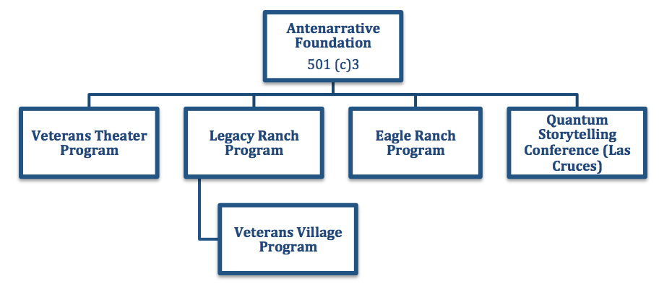
501(c)3 ANTENARRATIVE FOUNDATION
ANTENARRATIVE Foundation Board of Trustees
David M. Boje, (Veteran Army) President & NMSU Regents Professor
(575)-936-9578 (cell) or David@davidboje.com
James Sassak, VP
Nancy Starr Breard, EDD, Treasurer 864-706-4282
Ernest Ramey, Secretary (Veteran Army)
John Hawk, Agent-at-large (Veteran Navy)
Wanda Whittlesey-Jerome MSW Social Work NMSU Professor

Slide 4
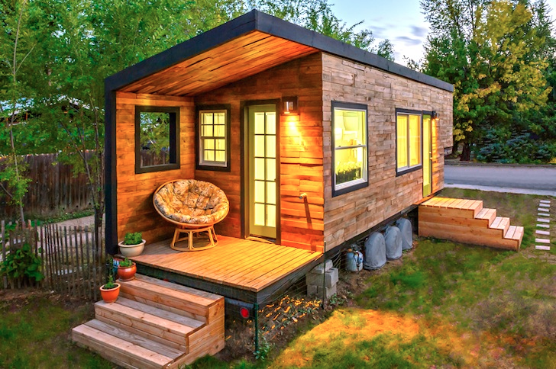
Low Cost NMSU Veterans Eco-Village Project Teams
Student Engineers Team: Supervisor – Shannon Reynolds
Jennifer Lopez Nawaf Alkhaldi
Colton Woodruff Paulina Orozco-Barraza
Clay Andrews Robin Leos
Leslie Hathaway Zack Robinson
Mia Brandt Omar Alajmi
Business Students for Sustainability Team:
Supervisor- David M. Boje
Sweata Lal, MBA
Samuel Buckingham, MBA
Sultan Almajroub, MBA

Slide 5
Executive Summary: Our Aim Today
We seek “partnership” with city and University for the Vision & Implementation of the VETERANS’ ECO-VILLAGE
e.g.

Slide 6
Vision Statement
Provide a two one-of-a-kind cutting-edge facilities:
One for Tiny Home housing student veterans and their families (A-Mountain) and opportunities with horses and retreats for post-deployment decompression at Legacy Ranch (old Rodeo facility).
Second homeless veterans and homeless (Burn Lake) to strengthen and heal themselves through a continuum of traditional and innovative treatment and the environment of Tiny Homes (lease or purchase), RV Tiny Home temporary stays, &/or weekend

Slide 7
Vision/Summary
Customize each Tiny Home to customer preferences for exterior and interior design
Price Range 23,000 to 33,000 each; Lease/Rent to Own Option
Keep homes on wheels
Use Sustainable construction materials
Has advantage of meeting demand for Tiny Home construction in New Mexico
Has advantage of transitioning existing construction trades to Green Design Principles

Slide 8
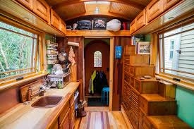
Mission Statement
Sustainable Tiny Homes in ECO-VILLAGES at NMSU and in Las Cruces would be a profitable and low cost investment for local businesses. They would be a valuable alternative for anyone who would like to live simply in a portable sustainable home and become self-reliant.

Slide 9
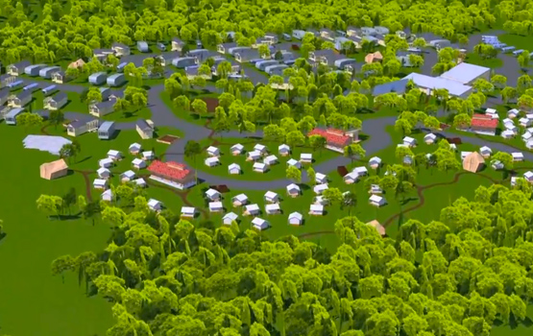
Eco-Village Concept, founded by Vietnam Veterans of Austin
E.g. Austin TX started with 27 acres (now 200 homes): Mobile Loaves and Fishes’ Alan Graham, says ‘one reason many in the nearby community are on board is because there will also be a bed and breakfast in the village and an Alamo Drafthouse outdoor movie theater. Graham adds that if 200 chronically homeless people get back on their feet, it could save Central Texas taxpayers about $10 million a year.

Slide 10
Partners
City of Las Cruces
NMSU & Vista College wants to participate
Veterans Groups want to participate
Churches/Synagogues want to participate
Manufacturers who want to model products (e.g. Tuff Shed; Omni Homes LLC’s Valante Thermocore Panel manufacturer; PV panel manufacturers)
Corporate involvement (Wal-Mart; McCoy’s) & shopping centers near University, and so on.

Slide 11
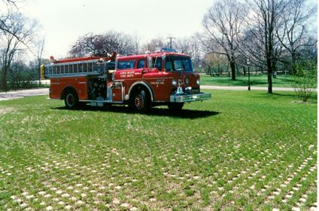
INFRASTRUCTURE
Roads: Has county roads (put in our own roads; we manufacture our own concrete mold path or solid pavers, no blacktop)
Water: Collect rain water (cisterns); Grey water storage (we build); need single line of water $1k per foot; pex it ourselves to sites; drainage
Electric: Grid tie Photovoltaic & windmills for self-sufficiency & solar generation payback
Sewage: black waste collection to one collection point & possibly one septic or sewer line connection
Solid Waste – weekly hauled from dumpster lease, after recycling

Slide 12
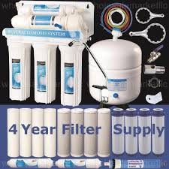
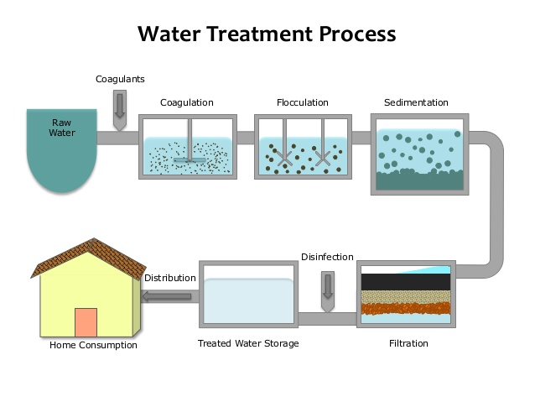
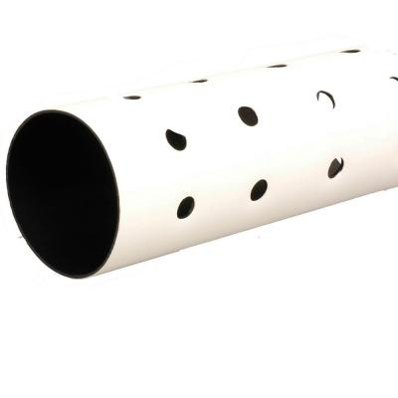
Water Treatment
Stages
-Disinfection
-Coagulation and flocculation
-Sedimentation
-Filtration
Filter systems
- In-line water system
- RO Drinking Water System
Grey water
-Dump
-Other Uses

Slide 13
Two Eco-Villages Implementation
PHASE I – Student Veterans Eco-Village (A Mountain) 2017 Start
PHASE II – Homeless Veterans Eco-Village (Burn Lake) 2019 Start

Slide 14
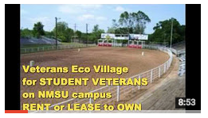
9 Minute YouTube
8:53
‪Veterans Ecological Villages for Las Cruces NEW MEXICO
David Boje

Slide 15
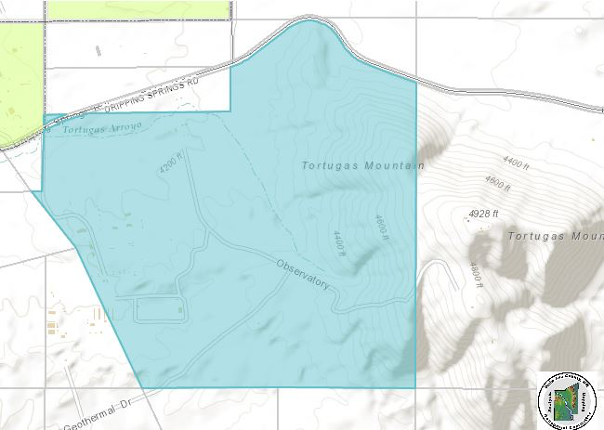
Phase 1 – Rodeo Property A Mountain

Slide 16
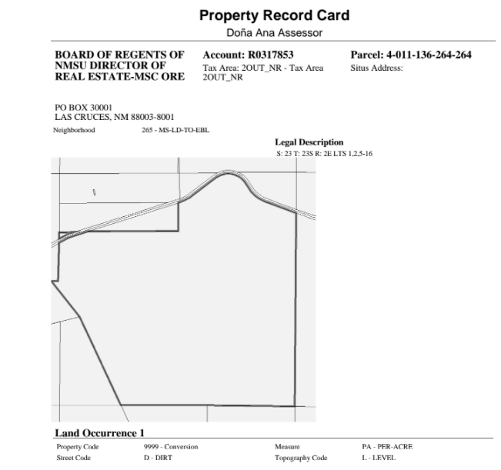

Slide 17
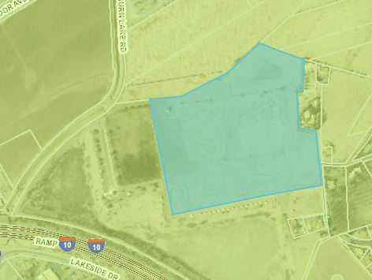
PHASE II – Burn Lake

Slide 18
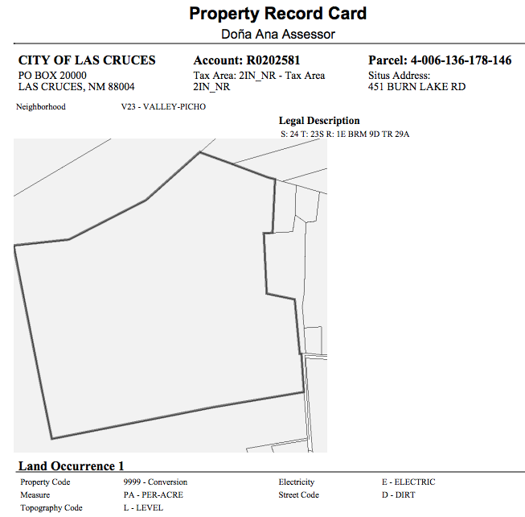

Slide 19
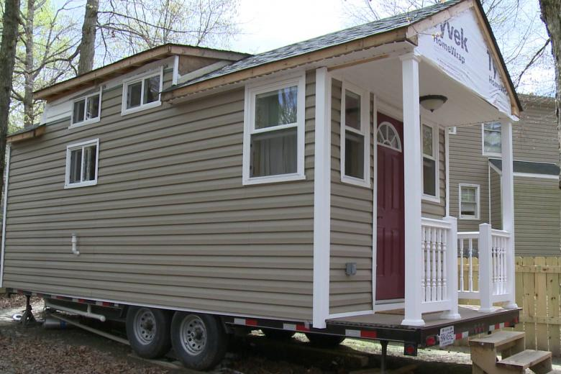
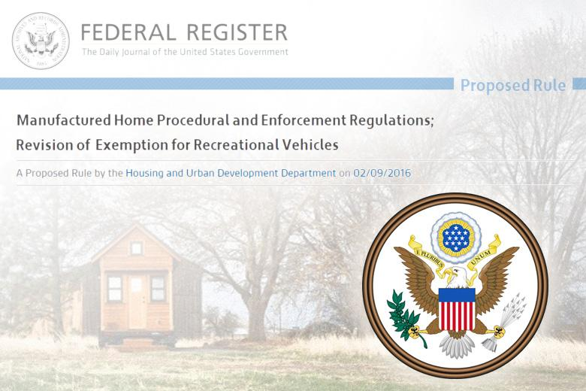
We use HUD codes, NOT RV codes
Definition of a Tiny House - Tiny Houses differ from existing classifications of recreational vehicles, manufactured housing, and homes on permanent foundations.
Notes:
- See more at: http://timbertrails.tv/Government-HUD-Rule-Could-Prohibit-Use-of-Tiny-House-as-Dwelling-Domicile-Primary-Residence#sthash.kqBOzfY0.dpuf

Slide 20
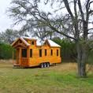
Resident Analysis
78% of Tiny House people own their home, compared to 65% of homeowners of traditional homes.
Average Tiny House is 186 sq/ft while a standard house takes up nearly 2100 sq/ft.
Average cost to build a Tiny House: $23,000
89% of Tiny House people have less credit card debt than the Average American.
55% of Tiny House people have more savings than the average American (i.e average of $10, 972 in the bank).

Slide 21
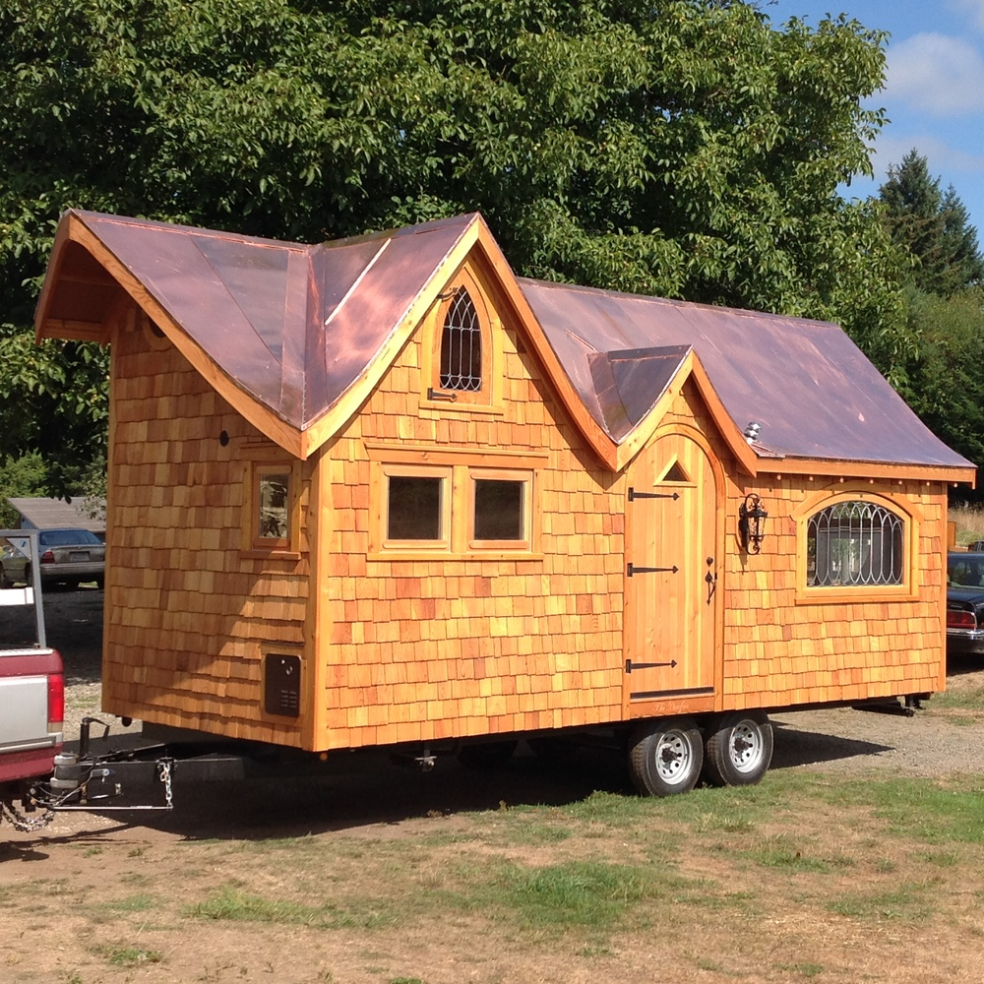
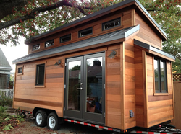
Code Analysis
Las Cruces Municipal Codes
Sec. 30-171. - Building permits and manufactured or mobile home installation permits
Sec. 30-172. - Mechanical/plumbing permits
Sec. 30-173. - Electrical permits
Sec. 30-656. - All manufactured and mobile homes require a permit for installation regardless of placement location. The purpose of these requirements is to ensure that manufactured and mobile homes are placed and maintained to provide safety for their residents.
(Ord. No. 2478, § I, 11-17-08)
Zoning : General Zoning Districts
Single-Family Rural Residential Zoning Districts
REM Single-Family Residential Estate Mobile
R-1cM Single-Family Low Density Mobile
R-1aM Single-Family Medium Density Mobile
R-1bM Single-Family High Density Mobile

Slide 22
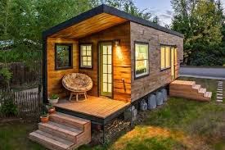
MICRO-ENTERPRISES POWERED BY VETERANS
Micro-Enterprises, such as E-Bay Store, Machine Shop, Carpentry, Organic Farming, and so on.
Micro-enterprises have one to five persons doing business
What about microenterprise constructing Tiny Homes on wheels using sustainable construction practices?

Slide 23
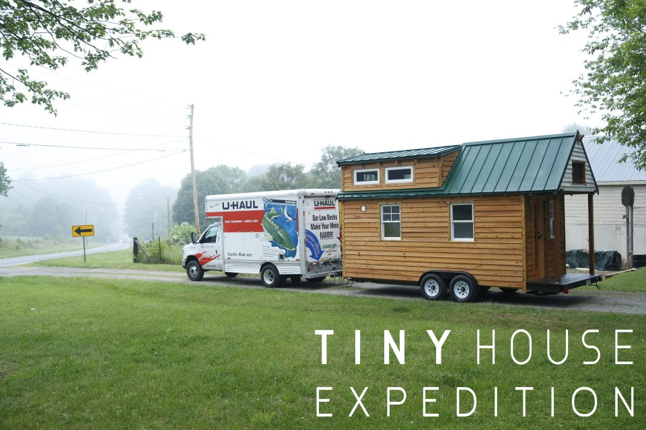
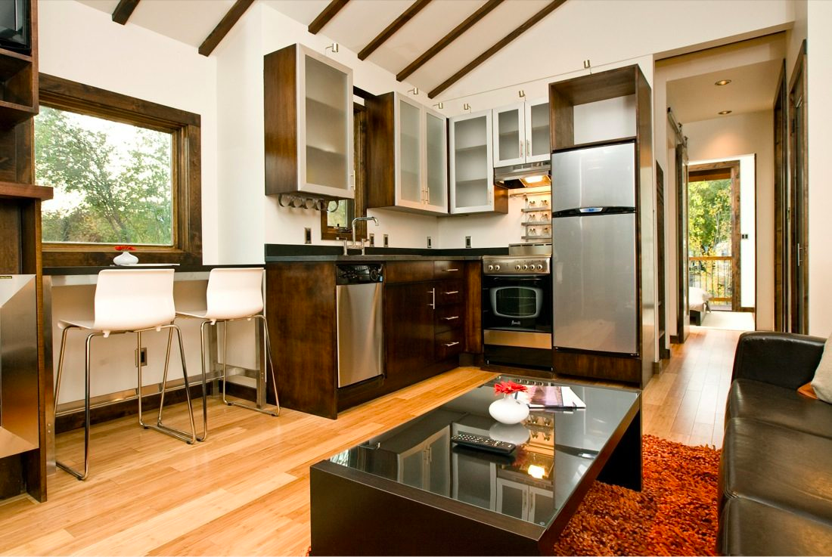
Ladies and Gentleman, Thank you for your time today! We seek your partnership for this initiative and hope that you will take it into consideration and vote to partner with us. Contact David@davidboje.com

